Slide 1
W4111 – Introduction to Databases Section 002, Fall 2023 Lecture 11: Module II, NoSQL, Part 4
© Donald F. Ferguson, 2023

Slide 2

Contents
2 | COMS W4111_002_2023_3: Lecture_11_Module_II_NoSQL_4 © Donald F. Ferguson, 2023

Slide 3
Contents
Module II (DBMS Implementation) Final Topics
Query Processing (chapter 15)
Query Optimization (chapter 16)
Transactions
Transactions (chapter 17)
Concurrency Control (chapter 18)
Recovery (chapter 19)
Relational Database Design Theory, aka Normalization
Begin Module IV – Data Analysis
Concepts
CQRS example
GoT Applications
Each of these chapters is an entire semesters (or more) topic.
We will cover core concepts in class.
HW/Final will ask questions that require some independent reading of book slides or material.
Lecture will rely mostly on slides.

Slide 4
Query Processing
4 | COMS W4111_002_2023_3: Lecture_11_Module_II_NoSQL_4 © Donald F. Ferguson, 2023

Slide 5

Query Processing
5 | COMS W4111_002_2023_3: Lecture_11_Module_II_NoSQL_4 © Donald F. Ferguson, 2023

Slide 6

Transactions
Find things quickly.
Load/Save quickly.
Transactions
Durability
Database Systems: The Complete Book (2nd Edition) by Hector Garcia-Molina (Author), Jeffrey D. Ullman (Author), Jennifer Widom (Author)

Slide 7
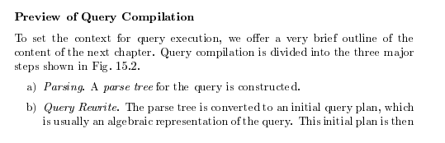
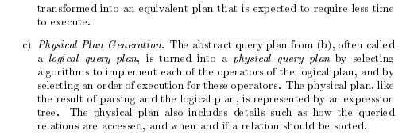
Query Compilation
Database Systems: The Complete Book (2nd Edition) 2nd Edition
by Hector Garcia-Molina (Author), Jeffrey D. Ullman (Author), Jennifer Widom (Author)

Slide 8
Parsing and Execution
Parser/Translator
Verifies syntax correctness and generates a parse tree.
Converts to logical plan tree that defines how to execute the query.
Tree nodes are operator(tables, parameters)
Edges are the flow of data “up the tree” from node to node.
Optimizer
Modifies the logical plan to define an improved execution.
Query rewrite/transformation.
Determines how to choose among multiple implementations of operators.
Engine
Executes the plan
May modify the plan to optimize execution, e.g. using indexes.

Slide 9
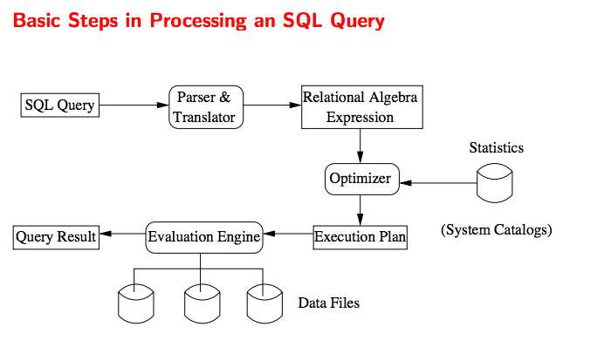
Query Processing Overview

Slide 10
Chapter 15: Query Processing

Slide 11
Chapter 15: Query Processing
Overview
Measures of Query Cost
Selection Operation
Sorting
Join Operation
Other Operations
Evaluation of Expressions

Slide 12
Basic Steps in Query Processing
1. Parsing and translation
2. Optimization
3. Evaluation

Slide 13
Basic Steps in Query Processing (Cont.)
Parsing and translation
translate the query into its internal form. This is then translated into relational algebra.
Parser checks syntax, verifies relations
Evaluation
The query-execution engine takes a query-evaluation plan, executes that plan, and returns the answers to the query.

Slide 14
Basic Steps in Query Processing: Optimization
A relational algebra expression may have many equivalent expressions
E.g., σ_{salary<75000}(∏_{salary}(instructor)) is equivalent to ∏_{salary}(σ_{salary<75000}(instructor))
Each relational algebra operation can be evaluated using one of several different algorithms
Correspondingly, a relational-algebra expression can be evaluated in many ways.
Annotated expression specifying detailed evaluation strategy is called an evaluation-plan. E.g.,:
Use an index on salary to find instructors with salary < 75000,
Or perform complete relation scan and discard instructors with salary ≥ 75000

Slide 15
Basic Steps: Optimization (Cont.)
Query Optimization: Amongst all equivalent evaluation plans choose the one with lowest cost.
Cost is estimated using statistical information from the database catalog
e.g.. number of tuples in each relation, size of tuples, etc.
In this chapter we study
How to measure query costs
Algorithms for evaluating relational algebra operations
How to combine algorithms for individual operations in order to evaluate a complete expression
In Chapter 16
We study how to optimize queries, that is, how to find an evaluation plan with lowest estimated cost

Slide 16
Measures of Query Cost
Many factors contribute to time cost
disk access, CPU, and network communication
Cost can be measured based on
response time, i.e. total elapsed time for answering query, or
total resource consumption
We use total resource consumption as cost metric
Response time harder to estimate, and minimizing resource consumption is a good idea in a shared database
We ignore CPU costs for simplicity
Real systems do take CPU cost into account
Network costs must be considered for parallel systems
We describe how estimate the cost of each operation
We do not include cost to writing output to disk

Slide 17
Measures of Query Cost
Disk cost can be estimated as:
Number of seeks * average-seek-cost
Number of blocks read * average-block-read-cost
Number of blocks written * average-block-write-cost
For simplicity we just use the number of block transfers from disk and the number of seeks as the cost measures
t_{T} – time to transfer one block
Assuming for simplicity that write cost is same as read cost
t_{S} – time for one seek
Cost for b block transfers plus S seeks b * t_{T} + S * t_{S}
t_{S} and t_{T} depend on where data is stored; with 4 KB blocks:
High end magnetic disk: t_{S} = 4 msec and t_{T} =0.1 msec
SSD: t_{S} = 20-90 microsec and t_{T} = 2-10 microsec for 4KB

Slide 18
Measures of Query Cost (Cont.)
Required data may be buffer resident already, avoiding disk I/O
But hard to take into account for cost estimation
Several algorithms can reduce disk IO by using extra buffer space
Amount of real memory available to buffer depends on other concurrent queries and OS processes, known only during execution
Worst case estimates assume that no data is initially in buffer and only the minimum amount of memory needed for the operation is available
But more optimistic estimates are used in practice
Notes:
18

Slide 19
Selection Operation
File scan
Algorithm A1 (linear search). Scan each file block and test all records to see whether they satisfy the selection condition.
Cost estimate = b_{r} block transfers + 1 seek
b_{r} denotes number of blocks containing records from relation r
If selection is on a key attribute, can stop on finding record
cost = (b_{r} /2) block transfers + 1 seek
Linear search can be applied regardless of
selection condition or
ordering of records in the file, or
availability of indices
Note: binary search generally does not make sense since data is not stored consecutively
except when there is an index available,
and binary search requires more seeks than index search

Slide 20
Selections Using Indices
Index scan – search algorithms that use an index
selection condition must be on search-key of index.
A2 (clustering index, equality on key). Retrieve a single record that satisfies the corresponding equality condition
Cost = (h_{i} + 1) * (t_{T} + t_{S})
A3 (clustering index, equality on nonkey) Retrieve multiple records.
Records will be on consecutive blocks
Let b = number of blocks containing matching records
Cost = h_{i} * (t_{T} + t_{S}) + t_{S} + t_{T} * b

Slide 21
Selections Using Indices
A4 (secondary index, equality on key/non-key).
Retrieve a single record if the search-key is a candidate key
Cost = (h_{i} + 1) * (t_{T} + t_{S})
Retrieve multiple records if search-key is not a candidate key
each of n matching records may be on a different block
Cost = (h_{i} + n) * (t_{T} + t_{S})
Can be very expensive!
Notes:
21

Slide 22
Selections Involving Comparisons
Can implement selections of the form σ_{A≤V} (r) or σ_{A ≥ V}(r) by using
a linear file scan,
or by using indices in the following ways:
A5 (clustering index, comparison). (Relation is sorted on A)
For σ_{A ≥ V}(r) use index to find first tuple ≥ v and scan relation sequentially from there
For σ_{A≤V} (r) just scan relation sequentially till first tuple > v; do not use index
A6 (clustering index, comparison).
For σ_{A ≥ V}(r) use index to find first index entry ≥ v and scan index sequentially from there, to find pointers to records.
For σ_{A≤V} (r) just scan leaf pages of index finding pointers to records, till first entry > v
In either case, retrieve records that are pointed to
requires an I/O per record; Linear file scan may be cheaper!

Slide 23
Implementation of Complex Selections
Conjunction: σ_{θ1}∧ _{θ2}∧. . . _{θn}(r)
A7 (conjunctive selection using one index).
Select a combination of θ_{i} and algorithms A1 through A7 that results in the least cost for σ_{θi} (r).
Test other conditions on tuple after fetching it into memory buffer.
A8 (conjunctive selection using composite index).
Use appropriate composite (multiple-key) index if available.
A9 (conjunctive selection by intersection of identifiers).
Requires indices with record pointers.
Use corresponding index for each condition, and take intersection of all the obtained sets of record pointers.
Then fetch records from file
If some conditions do not have appropriate indices, apply test in memory.

Slide 24
Algorithms for Complex Selections
Disjunction:σ_{θ1}∨ _{θ2} ∨. . . _{θn} (r).
A10 (disjunctive selection by union of identifiers).
Applicable if all conditions have available indices.
Otherwise use linear scan.
Use corresponding index for each condition, and take union of all the obtained sets of record pointers.
Then fetch records from file
Negation: σ_{¬θ}(r)
Use linear scan on file
If very few records satisfy ¬θ, and an index is applicable to θ
Find satisfying records using index and fetch from file

Slide 25
Sorting
We may build an index on the relation, and then use the index to read the relation in sorted order. May lead to one disk block access for each tuple.
For relations that fit in memory, techniques like quicksort can be used.
For relations that don’t fit in memory, external sort-merge is a good choice.

Slide 26
Join Operation
Several different algorithms to implement joins
Nested-loop join
Block nested-loop join
Indexed nested-loop join
Merge-join
Hash-join
Choice based on cost estimate
Examples use the following information
Number of records of student: 5,000 takes: 10,000
Number of blocks of student: 100 takes: 400

Slide 27
Nested-Loop Join
To compute the theta join r ⨝ _{θ} s for each tuple t_{r} in r do begin for each tuple t_{s} in s do begin test pair (t_{r},t_{s}) to see if they satisfy the join condition θ if they do, add t_{r} • t_{s} to the result. end end
r is called the outer relation and s the inner relation of the join.
Requires no indices and can be used with any kind of join condition.
Expensive since it examines every pair of tuples in the two relations.

Slide 28
Nested-Loop Join (Cont.)
In the worst case, if there is enough memory only to hold one block of each relation, the estimated cost is n_{r} ∗ b_{s} + b_{r} block transfers, plus n_{r} + b_{r} seeks
If the smaller relation fits entirely in memory, use that as the inner relation.
Reduces cost to b_{r} + b_{s} block transfers and 2 seeks
Assuming worst case memory availability cost estimate is
with student as outer relation:
5000 ∗ 400 + 100 = 2,000,100 block transfers,
5000 + 100 = 5100 seeks
with takes as the outer relation
10000 ∗ 100 + 400 = 1,000,400 block transfers and 10,400 seeks
If smaller relation (student) fits entirely in memory, the cost estimate will be 500 block transfers.
Block nested-loops algorithm (next slide) is preferable.

Slide 29
Indexed Nested-Loop Join
Index lookups can replace file scans if
join is an equi-join or natural join and
an index is available on the inner relation’s join attribute
Can construct an index just to compute a join.
For each tuple t_{r} in the outer relation r, use the index to look up tuples in s that satisfy the join condition with tuple t_{r}.
Worst case: buffer has space for only one page of r, and, for each tuple in r, we perform an index lookup on s.
Cost of the join: b_{r} (t_{T} + t_{S}) + n_{r} ∗ c
Where c is the cost of traversing index and fetching all matching s tuples for one tuple or r
c can be estimated as cost of a single selection on s using the join condition.
If indices are available on join attributes of both r and s, use the relation with fewer tuples as the outer relation.

Slide 30
Merge-Join
1. Sort both relations on their join attribute (if not already sorted on the join
attributes).
2. Merge the sorted relations to join them
1. Join step is similar to the merge stage of the sort-merge algorithm.
2. Main difference is handling of duplicate values in join attribute —
every pair with same value on join attribute must be matched
3. Detailed algorithm in book

Slide 31
Merge-Join (Cont.)
Can be used only for equi-joins and natural joins
Each block needs to be read only once (assuming all tuples for any given value of the join attributes fit in memory
Thus the cost of merge join is: b_{r} + b_{s} block transfers + ⎡b_{r} / b_{b}⎤ + ⎡b_{s} / b_{b}⎤ seeks
+ the cost of sorting if relations are unsorted.
hybrid merge-join: If one relation is sorted, and the other has a secondary B⁺-tree index on the join attribute
Merge the sorted relation with the leaf entries of the B⁺-tree .
Sort the result on the addresses of the unsorted relation’s tuples
Scan the unsorted relation in physical address order and merge with previous result, to replace addresses by the actual tuples
Sequential scan more efficient than random lookup

Slide 32
Hash-Join
Applicable for equi-joins and natural joins.
A hash function h is used to partition tuples of both relations
h maps JoinAttrs values to {0, 1, ..., n}, where JoinAttrs denotes the common attributes of r and s used in the natural join.
r₀, r₁, . . ., r_{n} denote partitions of r tuples
Each tuple t_{r} ∈ r is put in partition r_{i} where i = h(t_{r} [JoinAttrs]).
r₀,, r₁. . ., r_{n} denotes partitions of s tuples
Each tuple t_{s} ∈s is put in partition s_{i}, where i = h(t_{s} [JoinAttrs]).
Note: In book, Figure 12.10 r_{i} is denoted as H_{ri,} s_{i} is denoted as H_{si} and n is denoted as n_{h.}

Slide 33
Hash-Join (Cont.)

Slide 34
Hash-Join (Cont.)
r tuples in r_{i} need only to be compared with s tuples in s_{i} Need not be compared with s tuples in any other partition, since:
an r tuple and an s tuple that satisfy the join condition will have the same value for the join attributes.
If that value is hashed to some value i, the r tuple has to be in r_{i} and the s tuple in s_{i}.

Slide 35
Hash-Join Algorithm
The hash-join of r and s is computed as follows.
1. Partition the relation s using hashing function h. When partitioning a relation, one block of memory is reserved as the output buffer for each partition.
2. Partition r similarly.
3. For each i:
(a) Load s_{i} into memory and build an in-memory hash index on it using the join attribute. This hash index uses a different hash function than the earlier one h.
(b) Read the tuples in r_{i} from the disk one by one. For each tuple t_{r} locate each matching tuple t_{s} in s_{i} using the in-memory hash index. Output the concatenation of their attributes.
Relation s is called the build input and r is called the probe input.

Slide 36
Hash-Join algorithm (Cont.)
The value n and the hash function h is chosen such that each s_{i} should fit in memory.
Typically n is chosen as ⎡b_{s}/M⎤ * f where f is a “fudge factor”, typically around 1.2
The probe relation partitions s_{i} need not fit in memory
Recursive partitioning required if number of partitions n is greater than number of pages M of memory.
instead of partitioning n ways, use M – 1 partitions for s
Further partition the M – 1 partitions using a different hash function
Use same partitioning method on r
Rarely required: e.g., with block size of 4 KB, recursive partitioning not needed for relations of < 1GB with memory size of 2MB, or relations of < 36 GB with memory of 12 MB

Slide 37
Other Operations
Duplicate elimination can be implemented via hashing or sorting.
On sorting duplicates will come adjacent to each other, and all but one set of duplicates can be deleted.
Optimization: duplicates can be deleted during run generation as well as at intermediate merge steps in external sort-merge.
Hashing is similar – duplicates will come into the same bucket.
Projection:
perform projection on each tuple
followed by duplicate elimination.

Slide 38
Other Operations : Aggregation
Aggregation can be implemented in a manner similar to duplicate elimination.
Sorting or hashing can be used to bring tuples in the same group together, and then the aggregate functions can be applied on each group.
Optimization: partial aggregation
combine tuples in the same group during run generation and intermediate merges, by computing partial aggregate values
For count, min, max, sum: keep aggregate values on tuples found so far in the group.
When combining partial aggregate for count, add up the partial aggregates
For avg, keep sum and count, and divide sum by count at the end

Slide 39
Evaluation of Expressions
So far: we have seen algorithms for individual operations
Alternatives for evaluating an entire expression tree
Materialization: generate results of an expression whose inputs are relations or are already computed, materialize (store) it on disk. Repeat.
Pipelining: pass on tuples to parent operations even as an operation is being executed
We study above alternatives in more detail

Slide 40
Materialization
Materialized evaluation: evaluate one operation at a time, starting at the lowest-level. Use intermediate results materialized into temporary relations to evaluate next-level operations.
E.g., in figure below, compute and store then compute the store its join with instructor, and finally compute the projection on name.

Slide 41
Materialization (Cont.)
Materialized evaluation is always applicable
Cost of writing results to disk and reading them back can be quite high
Our cost formulas for operations ignore cost of writing results to disk, so
Overall cost = Sum of costs of individual operations + cost of writing intermediate results to disk
Double buffering: use two output buffers for each operation, when one is full write it to disk while the other is getting filled
Allows overlap of disk writes with computation and reduces execution time

Slide 42
Pipelining
Pipelined evaluation: evaluate several operations simultaneously, passing the results of one operation on to the next.
E.g., in previous expression tree, don’t store result of
instead, pass tuples directly to the join.. Similarly, don’t store result of join, pass tuples directly to projection.
Much cheaper than materialization: no need to store a temporary relation to disk.
Pipelining may not always be possible – e.g., sort, hash-join.
For pipelining to be effective, use evaluation algorithms that generate output tuples even as tuples are received for inputs to the operation.
Pipelines can be executed in two ways: demand driven and producer driven

Slide 43
Pipelining (Cont.)
In demand driven or lazy evaluation
system repeatedly requests next tuple from top level operation
Each operation requests next tuple from children operations as required, in order to output its next tuple
In between calls, operation has to maintain “state” so it knows what to return next
In producer-driven or eager pipelining
Operators produce tuples eagerly and pass them up to their parents
Buffer maintained between operators, child puts tuples in buffer, parent removes tuples from buffer
if buffer is full, child waits till there is space in the buffer, and then generates more tuples
System schedules operations that have space in output buffer and can process more input tuples
Alternative name: pull and push models of pipelining

Slide 44
Pipelining (Cont.)
Implementation of demand-driven pipelining
Each operation is implemented as an iterator implementing the following operations
open()
E.g., file scan: initialize file scan
state: pointer to beginning of file
E.g., merge join: sort relations;
state: pointers to beginning of sorted relations
next()
E.g., for file scan: Output next tuple, and advance and store file pointer
E.g., for merge join: continue with merge from earlier state till next output tuple is found. Save pointers as iterator state.
close()

Slide 45
Query Optimization
45 | COMS W4111_002_2023_3: Lecture_11_Module_II_NoSQL_4 © Donald F. Ferguson, 2023

Slide 46
Chapter 16: Query Optimization

Slide 47
Outline
Introduction
Transformation of Relational Expressions
Catalog Information for Cost Estimation
Statistical Information for Cost Estimation
Cost-based optimization
Dynamic Programming for Choosing Evaluation Plans
Materialized views

Slide 48
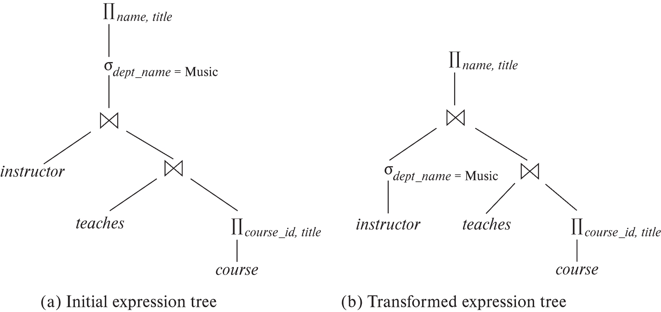
Introduction
Alternative ways of evaluating a given query
Equivalent expressions
Different algorithms for each operation

Slide 49
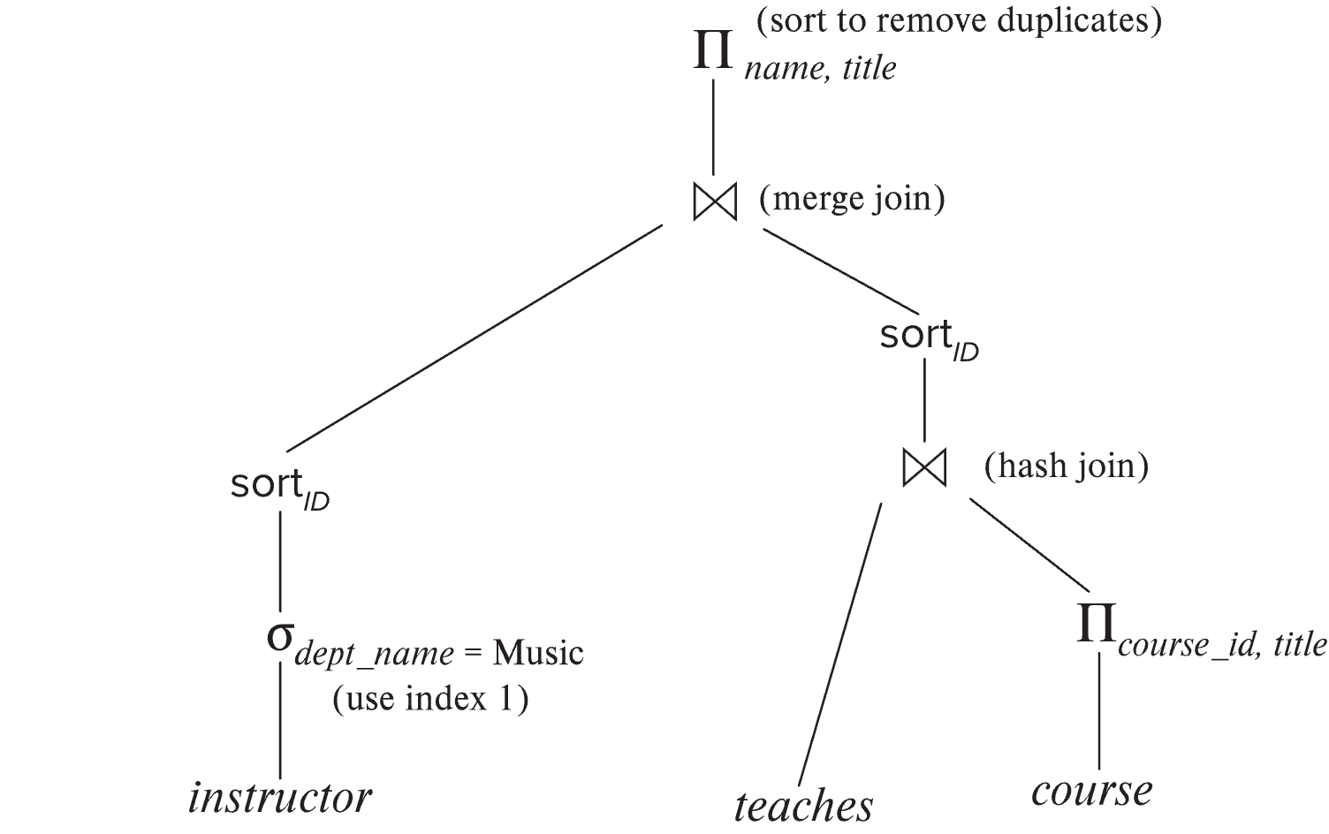
Introduction (Cont.)
An evaluation plan defines exactly what algorithm is used for each operation, and how the execution of the operations is coordinated.
Find out how to view query execution plans on your favorite database

Slide 50
Introduction (Cont.)
Cost difference between evaluation plans for a query can be enormous
E.g., seconds vs. days in some cases
Steps in cost-based query optimization
1. Generate logically equivalent expressions using equivalence rules
2. Annotate resultant expressions to get alternative query plans
3. Choose the cheapest plan based on estimated cost
Estimation of plan cost based on:
Statistical information about relations. Examples:
number of tuples, number of distinct values for an attribute
Statistics estimation for intermediate results
to compute cost of complex expressions
Cost formulae for algorithms, computed using statistics

Slide 51
Viewing Query Evaluation Plans
Most database support explain <query>
Displays plan chosen by query optimizer, along with cost estimates
Some syntax variations between databases
Oracle: explain plan for <query> followed by select * from table (dbms_xplan.display)
SQL Server: set showplan_text on
Some databases (e.g. PostgreSQL) support explain analyse <query>
Shows actual runtime statistics found by running the query, in addition to showing the plan
Some databases (e.g. PostgreSQL) show cost as f..l
f is the cost of delivering first tuple and l is cost of delivering all results

Slide 52
Generating Equivalent Expressions

Slide 53
Transformation of Relational Expressions
Two relational algebra expressions are said to be equivalent if the two expressions generate the same set of tuples on every legal database instance
Note: order of tuples is irrelevant
we don’t care if they generate different results on databases that violate integrity constraints
In SQL, inputs and outputs are multisets of tuples
Two expressions in the multiset version of the relational algebra are said to be equivalent if the two expressions generate the same multiset of tuples on every legal database instance.
An equivalence rule says that expressions of two forms are equivalent
Can replace expression of first form by second, or vice versa

Slide 54
Equivalence Rules
1. Conjunctive selection operations can be deconstructed into a sequence of individual selections. σ_{θ1 ∧ θ2} (E) ≡ σ_{θ1} (σ_{θ2} (E))
2. Selection operations are commutative. σ_{θ1}(σ_{θ2}(E)) ≡ σ_{θ2} (σ_{θ1}(E))
3. Only the last in a sequence of projection operations is needed, the others can be omitted. ∏ _{L1}(∏ _{L2}(…(∏ _{Ln}(E))…)) ≡ ∏ _{L1}(E) where L₁ ⊆ L₂ … ⊆ L_{n}
4. Selections can be combined with Cartesian products and theta joins.
σ_{θ} (E₁ x E₂) ≡ E₁ ⨝ _{θ} E₂
σ _{θ1} (E₁ ⨝_{θ2} E₂) ≡ E₁ ⨝ _{θ1∧θ2} E₂

Slide 55
Equivalence Rules (Cont.)
5. Theta-join operations (and natural joins) are commutative. E₁ ⨝ E₂ ≡ E₂ ⨝ E₁
6. (a) Natural join operations are associative:
(E₁ ⨝ E₂) ⨝ E₃ ≡ E₁ ⨝ (E₂ ⨝ E₃) (b) Theta joins are associative in the following manner: (E₁ ⨝ _{θ1} E₂) ⨝ _{θ2 ∧ θ3} E₃ ≡ E₁ ⨝_{θ1 ∧ θ3} (E₂ ⨝ _{θ2} E₃) where θ₂ involves attributes from only E₂ and E₃.

Slide 56
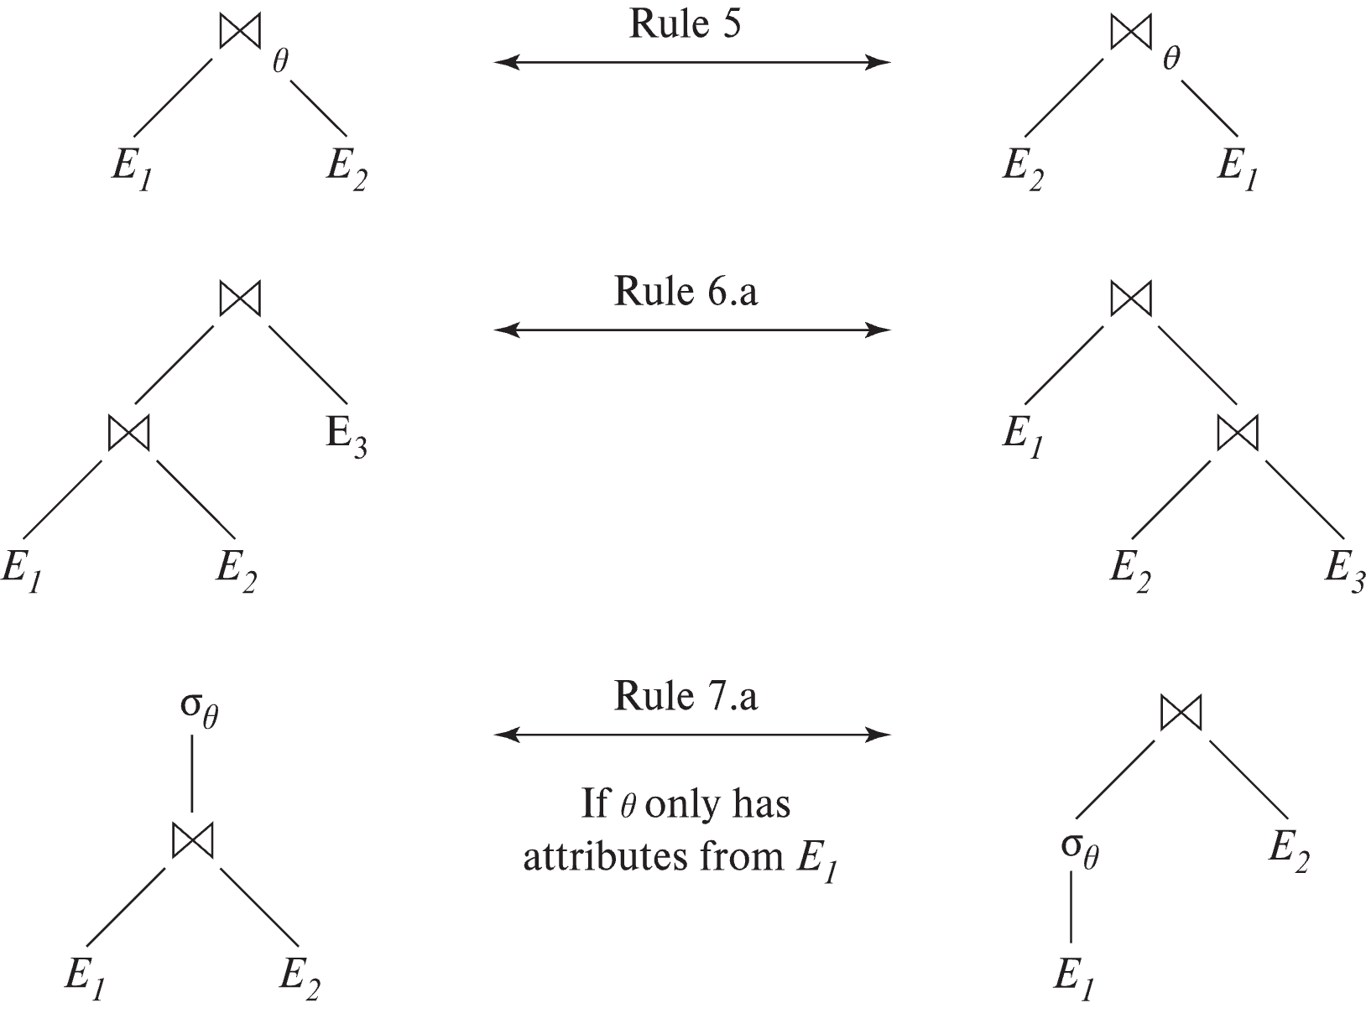
Pictorial Depiction of Equivalence Rules

Slide 57
Equivalence Rules (Cont.)
7. The selection operation distributes over the theta join operation under the following two conditions: (a) When all the attributes in θ₀ involve only the attributes of one of the expressions (E₁) being joined. σ_{θ0} (E₁ ⨝_{θ} E₂) ≡ (σ_{θ0}(E₁)) ⨝_{θ} E₂
(b) When θ₁ involves only the attributes of E₁ and θ₂ involves only the attributes of E₂.
σ_{θ1 ∧ θ2} (E₁ ⨝_{θ} E₂) ≡ (σ_{θ1}(E₁)) ⨝_{θ} (σ_{θ2}(E₂))

Slide 58
Equivalence Rules (Cont.)
8. The projection operation distributes over the theta join operation as follows:
(a) if θ involves only attributes from L₁ ∪ L₂: ∏ _{L1 ∪ L2}(E₁ ⨝_{θ} E₂) ≡ ∏ _{L1}(E₁) ⨝_{θ} ∏ _{L2}(E₂)
(b) In general, consider a join E₁ ⨝_{θ} E₂.
Let L₁ and L₂ be sets of attributes from E₁ and E₂, respectively.
Let L₃ be attributes of E₁ that are involved in join condition θ, but are not in L₁ ∪ L₂, and
let L₄ be attributes of E₂ that are involved in join condition θ, but are not in L₁ ∪ L₂. ∏ _{L1 ∪ L2}(E₁ ⨝_{θ} E₂) ≡ ∏ _{L1 ∪ L2}(∏ _{L1 ∪ L3}(E₁) ⨝_{θ} ∏ _{L2 ∪ L4}(E₂))
Similar equivalences hold for outerjoin operations: ⟕, ⟖, and ⟗

Slide 59
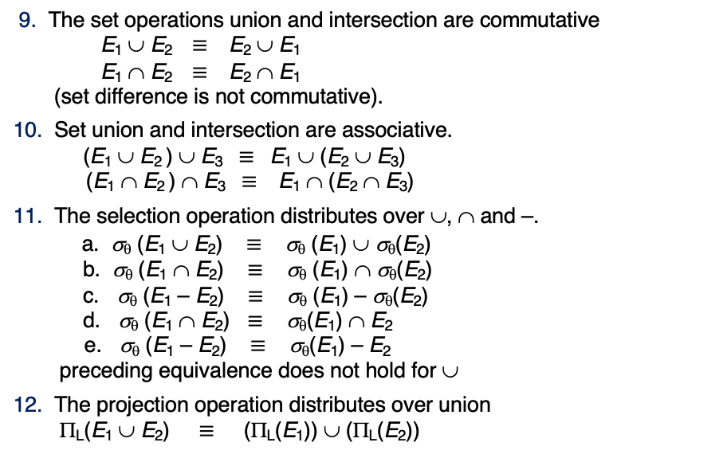
Equivalence Rules (Cont.)
9. The set operations union and intersection are commutative E₁ ∪ E₂ ≡ E₂ ∪ E₁ E₁ ∩ E₂ ≡ E₂ ∩ E₁ (set difference is not commutative).
10. Set union and intersection are associative. (E₁ ∪ E₂ ) ∪ E₃ ≡ E₁ ∪ (E₂ ∪ E₃) (E₁ ∩ E₂ ) ∩ E₃ ≡ E₁ ∩ (E₂ ∩ E₃)
11. The selection operation distributes over ∪, ∩ and –. a. σ_{θ} (E₁ ∪ E₂) ≡ σ_{θ} (E₁) ∪ σ_{θ}(E₂) b. σ_{θ} (E₁ ∩ E₂) ≡ σ_{θ} (E₁) ∩ σ_{θ}(E₂) c. σ_{θ} (E₁ – E₂) ≡ σ_{θ} (E₁) – σ_{θ}(E₂) d. σ_{θ} (E₁ ∩ E₂) ≡ σ_{θ}(E₁) ∩ E₂ e. σ_{θ} (E₁ – E₂) ≡ σ_{θ}(E₁) – E₂ preceding equivalence does not hold for ∪
12. The projection operation distributes over union Π_{L}(E₁ ∪ E₂) ≡ (Π_{L}(E₁)) ∪ (Π_{L}(E₂))

Slide 60
Equivalence Rules (Cont.)
13. Selection distributes over aggregation as below σ_{θ}(_{G}𝛾_{A}(E)) ≡ _{G}𝛾_{A}(σ_{θ}(E)) provided θ only involves attributes in G
14. a. Full outerjoin is commutative: E₁ ⟗ E₂ ≡ E₂ ⟗ E₁ b. Left and right outerjoin are not commutative, but: E₁ ⟕ E₂ ≡ E₂ ⟖ E₁
15. Selection distributes over left and right outerjoins as below, provided θ₁
only involves attributes of E₁ a. σ_{θ1} (E₁ ⟕_{θ} E₂) ≡ (σ_{θ1} (E₁)) ⟕_{θ} E₂ b. σ_{θ1} (E₁ ⟖_{θ} E₂) ≡ E₂ ⟕_{θ} (σ_{θ1} (E₁))
16. Outerjoins can be replaced by inner joins under some conditions
a. σ_{θ1} (E₁ ⟕_{θ} E₂) ≡ σ_{θ1} (E₁ ⨝_{θ} E₂) b. σ_{θ1} (E₁ ⟖_{θ} E₁) ≡ σ_{θ1} (E₁ ⨝_{θ} E₂) provided θ₁ is null rejecting on E₂

Slide 61
Equivalence Rules (Cont.)
Note that several equivalences that hold for joins do not hold for outerjoins
σ_{year=2017}(instructor ⟕ teaches) ≢ σ_{year=2017}(instructor ⨝ teaches)
Outerjoins are not associative (r ⟕ s) ⟕ t ≢ r ⟕ (s ⟕ t)
e.g. with r(A,B) = {(1,1), s(B,C) = { (1,1)}, t(A,C) = { }
Notes:
How about (r ⟕ s) ⟕ t vs (r ⟕ t) ⟕ s assuming r has common attributes with s and t? Hint: consider 2 cases where s and t have common attributes and those where they have no common attribute

Slide 62
Transformation Example: Pushing Selections
Query: Find the names of all instructors in the Music department, along with the titles of the courses that they teach
Π_{name, title}(σ_{dept_name= ‘Music’} (instructor ⨝ (teaches ⨝ Π_{course_id, title} (course))))
Transformation using rule 7a.
Π_{name, title}((σ_{dept_name= ‘Music’}(instructor)) ⨝ (teaches ⨝ Π_{course_id, title} (course)))
Performing the selection as early as possible reduces the size of the relation to be joined.

Slide 63
Example with Multiple Transformations
Query: Find the names of all instructors in the Music department who have taught a course in 2017, along with the titles of the courses that they taught
Π_{name, title}(σ_{dept_name= "Music”∧year = 2017} (instructor ⨝ (teaches ⨝ Π_{course_id, title} (course))))
Transformation using join associatively (Rule 6a):
Π_{name, title}(σ_{dept_name= “Music”∧year = 2017} ((instructor ⨝ teaches) ⨝ Π_{course_id, title} (course)))
Second form provides an opportunity to apply the “perform selections early” rule, resulting in the subexpression
σ_{dept_name = “Music”} (instructor) ⨝ σ _{year = 2017} (teaches)

Slide 64
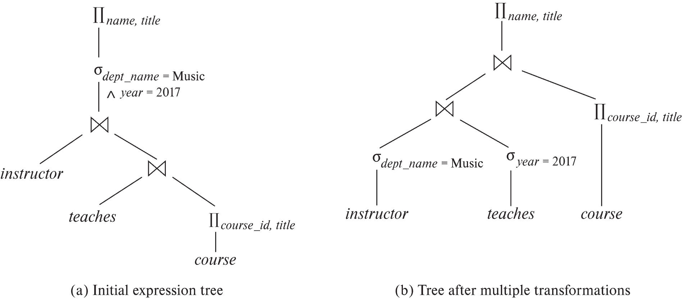
Multiple Transformations (Cont.)

Slide 65
Transformation Example: Pushing Projections
Consider: Π_{name, title}(σ_{dept_name= “Music”} (instructor) ⨝ teaches) ⨝ Π_{course_id, title} (course))))
When we compute
(σ_{dept_name = “Music”} (instructor ⨝ teaches)
we obtain a relation whose schema is: (ID, name, dept_name, salary, course_id, sec_id, semester, year)
Push projections using equivalence rules 8a and 8b; eliminate unneeded attributes from intermediate results to get: Π_{name, title}(Π_{name, course_id} ( σ_{dept_name= “Music”} (instructor) ⨝ teaches)) ⨝ Π_{course_id, title} (course))))
Performing the projection as early as possible reduces the size of the relation to be joined.

Slide 66
Join Ordering Example
For all relations r_{1,} r_{2,} and r₃,
(r₁ ⨝ r₂) ⨝ r₃ = r₁ ⨝ (r₂ ⨝ r₃ )
(Join Associativity) ⨝
If r₂ ⨝ r₃ is quite large and r₁ ⨝ r₂ is small, we choose
(r₁ ⨝ r₂) ⨝ r₃
so that we compute and store a smaller temporary relation.

Slide 67
Join Ordering Example (Cont.)
Consider the expression
Π_{name, title}(σ_{dept_name= “Music”} (instructor) ⨝ teaches) ⨝ Π_{course_id, title} (course))))
Could compute teaches ⨝ Π_{course_id, title} (course) first, and join result with σ_{dept_name= “Music”} (instructor) but the result of the first join is likely to be a large relation.
Only a small fraction of the university’s instructors are likely to be from the Music department
it is better to compute
σ_{dept_name= “Music”} (instructor) ⨝ teaches
first.

Slide 68
Enumeration of Equivalent Expressions
Query optimizers use equivalence rules to systematically generate expressions equivalent to the given expression
Can generate all equivalent expressions as follows:
Repeat
apply all applicable equivalence rules on every subexpression of every equivalent expression found so far
add newly generated expressions to the set of equivalent expressions
Until no new equivalent expressions are generated above
The above approach is very expensive in space and time
Two approaches
Optimized plan generation based on transformation rules
Special case approach for queries with only selections, projections and joins

Slide 69
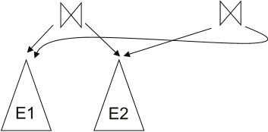
Implementing Transformation Based Optimization
Space requirements reduced by sharing common sub-expressions:
when E1 is generated from E2 by an equivalence rule, usually only the top level of the two are different, subtrees below are the same and can be shared using pointers
E.g., when applying join commutativity
Same sub-expression may get generated multiple times
Detect duplicate sub-expressions and share one copy
Time requirements are reduced by not generating all expressions
Dynamic programming
We will study only the special case of dynamic programming for join order optimization

Slide 70
Cost Estimation
Cost of each operator computer as described in Chapter 15
Need statistics of input relations
E.g., number of tuples, sizes of tuples
Inputs can be results of sub-expressions
Need to estimate statistics of expression results
To do so, we require additional statistics
E.g., number of distinct values for an attribute
More on cost estimation later

Slide 71
Choice of Evaluation Plans
Must consider the interaction of evaluation techniques when choosing evaluation plans
choosing the cheapest algorithm for each operation independently may not yield best overall algorithm. E.g.
merge-join may be costlier than hash-join, but may provide a sorted output which reduces the cost for an outer level aggregation.
nested-loop join may provide opportunity for pipelining
Practical query optimizers incorporate elements of the following two broad approaches:
1. Search all the plans and choose the best plan in a cost-based fashion.
2. Uses heuristics to choose a plan.

Slide 72
Cost-Based Optimization
Consider finding the best join-order for r₁ ⨝ r₂ ⨝ . . . ⨝ r_{n}.
There are (2(n – 1))!/(n – 1)! different join orders for above expression. With n = 7, the number is 665280, with n = 10, the number is greater than 176 billion!
No need to generate all the join orders. Using dynamic programming, the least-cost join order for any subset of {r₁, r₂, . . . r_{n}} is computed only once and stored for future use.

Slide 73
Statistics for Cost Estimation

Slide 74
Statistical Information for Cost Estimation
n_{r}: number of tuples in a relation r.
b_{r}: number of blocks containing tuples of r.
l_{r}: size of a tuple of r.
f_{r}: blocking factor of r — i.e., the number of tuples of r that fit into one block.
V(A, r): number of distinct values that appear in r for attribute A; same as the size of ∏_{A}(r).
If tuples of r are stored together physically in a file, then:

Slide 75
Histograms
Histogram on attribute age of relation person
Equi-width histograms
Equi-depth histograms break up range such that each range has (approximately) the same number of tuples
E.g. (4, 8, 14, 19)
Many databases also store n most-frequent values and their counts
Histogram is built on remaining values only

Slide 76
Histograms (cont.)
Histograms and other statistics usually computed based on a random sample
Statistics may be out of date
Some database require a analyze command to be executed to update statistics
Others automatically recompute statistics
e.g., when number of tuples in a relation changes by some percentage

Slide 77
Selection Size Estimation
σ_{A=v}(r)
n_{r} / V(A,r) : number of records that will satisfy the selection
Equality condition on a key attribute: size estimate = 1
σ_{A≤V}(r) (case of σ_{A ≥ V}(r) is symmetric)
Let c denote the estimated number of tuples satisfying the condition.
If min(A,r) and max(A,r) are available in catalog
c = 0 if v < min(A,r)
c =
If histograms available, can refine above estimate
In absence of statistical information c is assumed to be n_{r} / 2.

Slide 78
Transactions
78 | COMS W4111_002_2023_3: Lecture_11_Module_II_NoSQL_4 © Donald F. Ferguson, 2023

Slide 79
Concepts
79 | COMS W4111_002_2023_3: Lecture_11_Module_II_NoSQL_4 © Donald F. Ferguson, 2023

Slide 80
Transactions
Find things quickly.
Load/Save quickly.
Transactions
Durability
Database Systems: The Complete Book (2nd Edition) by Hector Garcia-Molina (Author), Jeffrey D. Ullman (Author), Jennifer Widom (Author)

Slide 81
Core Transaction Concept is ACID Properties
http://slideplayer.com/slide/9307681
ACID
Atomic
“ALL OR NOTHING”
Transaction cannot be subdivided
Consistent
Transaction → transforms database from one consistent state to another consistent state
Isolated
Transactions execute independently of one another
Database changes not revealed to users until after transaction has completed
Durable
Database changes are permanent
The permanence of the database’s consistent state

Slide 82
ACID Properties (httpwww.tutorialspoint.com/dbms/dbms_transaction.htm)
A transaction is a very small unit of a program and it may contain several low-level tasks. A transaction in a database system must maintain Atomicity, Consistency, Isolation, and Durability − commonly known as ACID properties − in order to ensure accuracy, completeness, and data integrity.
Atomicity − This property states that a transaction must be treated as an atomic unit, that is, either all of its operations are executed or none. There must be no state in a database where a transaction is left partially completed. States should be defined either before the execution of the transaction or after the execution/abortion/failure of the transaction.
Consistency − The database must remain in a consistent state after any transaction. No transaction should have any adverse effect on the data residing in the database. If the database was in a consistent state before the execution of a transaction, it must remain consistent after the execution of the transaction as well.
Durability − The database should be durable enough to hold all its latest updates even if the system fails or restarts. If a transaction updates a chunk of data in a database and commits, then the database will hold the modified data. If a transaction commits but the system fails before the data could be written on to the disk, then that data will be updated once the system springs back into action.
Isolation − In a database system where more than one transaction are being executed simultaneously and in parallel, the property of isolation states that all the transactions will be carried out and executed as if it is the only transaction in the system. No transaction will affect the existence of any other transaction.

Slide 83
Transaction Concept
A transaction is a unit of program execution that accesses and possibly updates various data items.
E.g., transaction to transfer $50 from account A to account B:
BEGIN TRANSACTION {
1. read(A)
2. A := A – 50
write(A)
4. read(B)
5. B := B + 50
write(B)
COMMIT or ROLLBACK }
Two main issues to deal with:
Failures of various kinds, such as hardware failures and system crashes
Concurrent execution of multiple transactions
BEGIN TRANSACTION {
1. read(A)
2. A := A – 50
write(A)
4. read(B)
5. B := B + 50
write(B)
COMMIT or ROLLBACK }

Slide 84
Example of Fund Transfer
T
Transaction to transfer $50 from account A to account B:
1. read(A)
2. A := A – 50
3. write(A)
4. read(B)
5. B := B + 50
6. write(B)
Atomicity requirement
If the transaction fails after step 3 and before step 6, money will be “lost” leading to an inconsistent database state
Failure could be due to software or hardware
The system should ensure that updates of a partially executed transaction are not reflected in the database
Durability requirement — once the user has been notified that the transaction has completed (i.e., the transfer of the $50 has taken place), the updates to the database by the transaction must persist even if there are software or hardware failures.
B
C

Slide 85
Example of Fund Transfer (Cont.)
Consistency requirement in above example:
The sum of A and B is unchanged by the execution of the transaction
In general, consistency requirements include
Explicitly specified integrity constraints such as primary keys and foreign keys
Implicit integrity constraints
e.g., sum of balances of all accounts, minus sum of loan amounts must equal value of cash-in-hand
A transaction must see a consistent database.
During transaction execution the database may be temporarily inconsistent.
When the transaction completes successfully the database must be consistent
Erroneous transaction logic can lead to inconsistency

Slide 86
Example of Fund Transfer (Cont.)
Isolation requirement — if between steps 3 and 6, another transaction T2 is allowed to access the partially updated database, it will see an inconsistent database (the sum A + B will be less than it should be).
T1 T2
1. read(A)
2. A := A – 50
write(A) read(A)
read(B) print(A+B)
4. read(B)
5. B := B + 50
6. write(B)
Isolation can be ensured trivially by running transactions serially
That is, one after the other.
However, executing multiple transactions concurrently has significant benefits, as we will see later.
T1, T2
T1
T2

Slide 87
Transaction State
Active – the initial state; the transaction stays in this state while it is executing
Partially committed – after the final statement has been executed.
Failed -- after the discovery that normal execution can no longer proceed.
Aborted – after the transaction has been rolled back and the database restored to its state prior to the start of the transaction. Two options after it has been aborted:
Restart the transaction
Can be done only if no internal logical error
Kill the transaction
Committed – after successful completion.

Slide 88
Atomicity Durability
88 | COMS W4111_002_2023_3: Lecture_11_Module_II_NoSQL_4 © Donald F. Ferguson, 2023

Slide 89
Atomicity
A transaction is a logical unit of work that must be either entirely completed or entirely undone. (All writes happen or none of them happen)
OK. What does this mean? Consider some pseudo-code
def transfer(source_acct_id, target_acct_id, amount)
Check that both accounts exist.
IF is_checking_account(source_acct_id)
Check that (source_acct.balance-amount) > source_account.overdraft_limit
ELSE
Check that (source_count.balance-amount) >source_account.minimum_balance
Update source account
Update target account.
INSERT a record into transfer tracking table.

Slide 90
Atomicity
A transaction is a logical unit of work that must be either entirely completed or entirely undone. (All writes happen or none of them happen)
OK. What does this mean? Consider some pseudo-code
def transfer(source_acct_id, target_acct_id, amount)
Check that both accounts exist.
IF is_checking_account(source_acct_id)
Check that (source_acct.balance-amount) > source_account.overdraft_limit
ELSE
Check that (source_count.balance-amount) >source_account.minimum_balance
Update source account
Update target account.
INSERT a record into transfer tracking table.
Computer or DB Server fails.

Slide 91
Atomicty
Transaction programs and databases are fast (milliseconds). What are the chances of the failure occurring in the wrong spot?
Well, that doesn’t really matter. If it happens,
Someone lost money and
There is no record off it. Someone is going to very upset.
Even a small server can have thousands of concurrent transactions ➔
There will be corruptions because some transaction will be in the wrong place at the wrong time.
Unless we do something in the DBMS
Because HW and software inevitably fail
And sadly, SW is especially prone to failure when under load

Slide 92
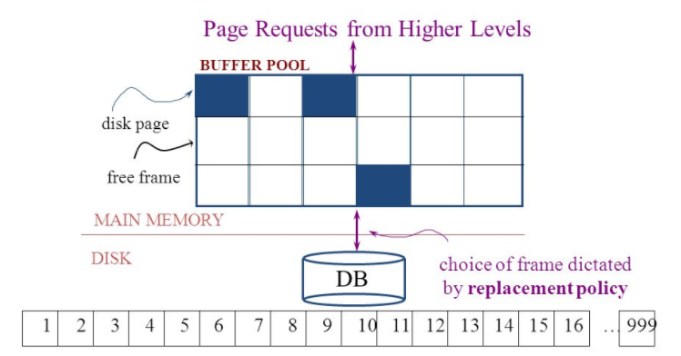
Simplistic Approach
Begin
Update A
Update B
Update C
Commit (REQ)
Force to disk
Commit (RSP)

Slide 93
Simplistic Approach
There are several problems with the simplistic approach.
The approach does not solve the problem
Some writes might succeed.
Some might be interrupted by the failure, or require retry.
Writes may be random and scattered. N updates might
Change a few bytes in N data frames
A few bytes in M index frames
Transaction rate becomes bottlenecked by write I/O rate, even though a relative small number of bytes change/transaction.
Written frames must be held in memory.
Lots of transactions
Randomly writing small pieces of lots of frames.
Consumes lots of memory with pinned pages.
Degrades the performance and optimization of the buffer.
The optimal buffer replacement policy wants to hold frames that will be reused.
Not frames that have been touched and never reused.

Slide 94
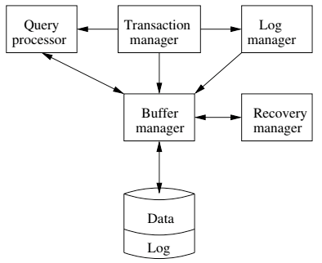
DBMS ACID Implementation
Implementation Subsystems
Query processor schedules and executes queries.
Buffer manager controls reading/writing blocks/frames to/from disk.
Log manager journals/records events to disk (log), e.g.
Transaction start/commit/abort
Transaction update of a block and previous value of data.
Transaction manager coordinates query scheduling, buffer read/write and logging to ensure ACID.
Recovery manager processes log to ensure ACID even after transaction or system failures.
Log is a special type of block file used by the system to optimize performance and ensure ACID.
Garcia-Molina et al., p. 846

Slide 95
Logging
The DBMS logs every transaction event
Log Sequence Number (LSN): A unique ID for a log record.
Prev LSN: A link to their last log record.
Transaction ID number.
Type: Describes the type of database log record.
Update Log Record
PageID: A reference to the Page ID of the modified page.
Length and Offset: Length in bytes and offset of the page are usually included.
Before and After Images of records.
Compensation Log Record
Commit Record
Abort Record Checkpoint Record
Completion Record notes that all work has been done for this particular transaction.

Slide 96
Write Ahead Logging
DBMS (Redo processing)
Write log events from all transactions into a single log stream.
Multiple events per page
Forces (writes) log record on COMMIT/ABORT
Single block I/O records many updates
Versus multiple block I/Os, each recording a single change.
All of a transaction’s updates recorded in one I/O versus many.
If there is a failure
DBMS sequentially reads log.
Applies changes to modified pages that were not saved to disk.
Then resumes normal processing.
Begin
Update A
Update B
Update C
Commit (REQ)
Force to disk
Commit (RSP)
Log

Slide 97
Write Ahead Logging
Force every write to disk?
Poor response time.
But provides durability.
Steal buffer-pool frames from uncommitted transactions?
If not, poor performance/caching performance
If yes, how can we ensure atomicity? Uncommitted updates on disk
DBMS (Undo processing)
Enable steal policy to improve cache performance by
Avoiding lots of pinned pages
Unlikely to be reused soon.
Before stealing
Force log record to disk.
Update log entry has data record
Before image
After image
If there is a failure
DBMS sequentially reads log.
Undoes changes to
modified pages, uncommitted pages
That were saved to disk.
Then resumes normal processing.
No Steal
Steal
Force
Trivial
No Force
Desired

Slide 98
ARIES Algorithm = Algorithms for Recovery and Isolation Exploiting Semantics
ARIES recovery involves three passes
Analysis pass:
Determine which transactions to undo
Determine which pages were dirty (disk version not up to date) at time of
RedoLSN: LSN from which redo should start
Redo pass:
Repeats history, redoing all actions from RedoLSN (updated committed but not written changes to pages)
RecLSN and PageLSNs are used to avoid redoing actions already reflected on page
Undo pass:
Rolls back all incomplete transactions (with uncommitted pages written to disk).
Transactions whose abort was complete earlier are not undone

Slide 99
Durability
Write changes to disk trivially achieves durability.
DBMS engine uses write-ahead-logging to
Achieve durability
But with better performance through more efficient caching and I/O.
Well, disks fail. How is that durable.
RAID and other solutions.
Disk subsystems, including entire RAID device, fail →
Duplex writes
To independent disk subsystems.
Well, there are earthquakes, floods, etc.

Slide 100
Availability and Replication
There are two basic patterns
Active/Passive
All requests go to master during normal processing.
Updates are transactionally queued for processing at passive backup.
Failure of master
Routes subsequent requests to backup.
Backup must process and commit updates before accepting requests.
Active/Active
Both environments process requests.
Some form of distributed transaction commit required to synchronize updates on both copies.
Multi-system communication to guarantee consistency is the foundation for tradeoffs in CAP.
The system can be CAP if and only iff
There are never any partitions or system failures
Which is unrealistic in cloud/Internet systems.

Slide 101
Isolation
101 | COMS W4111_002_2023_3: Lecture_11_Module_II_NoSQL_4 © Donald F. Ferguson, 2023

Slide 102
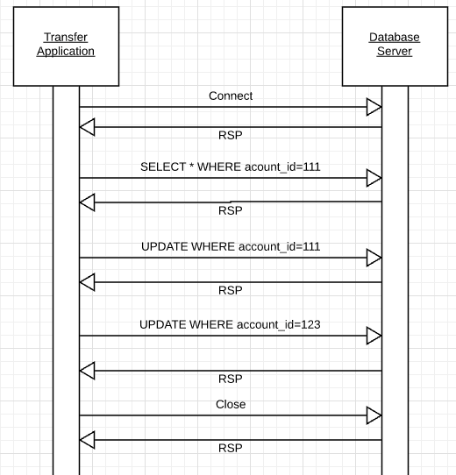
Isolation
Transfer $50 from
account_id=111 to
account_id=123
Requires 3 SQL statements
SELECT from 111 to check balance >= $50
UPDATE account_id=111
UPDATE account_id=123
There are some interesting scenarios
Two different programs read the balance ($51)
And decide removing $50 is OK.
DB constraints can prevent the conflict from happening, but …
There are more complex scenarios that constraints do not prevent.
Not ALL databases support constraints.
The “correct” execution should be that
One transaction responds “insufficient funds”
Before attempting transfer instead of after attempting.
Multiple readers

Slide 103
Isolation
Consider two simultaneous transfer transactions T1 and T2.
There are two equally correct executions
T1 transfers, T2 responds “insufficient funds” and does not attempt transfer
T2 transfers, T1 responds “insufficient funds” and does not attempt transfer
Each correct simultaneous execution is equivalent to a serial (sequential) execution schedule
(1) Execute T1, Execute T2
(2) Execute T2, Execute T1
NOTE:
We are focusing on correctness not
Fairness:
We do not care which transaction was actually submitted first.
And probably do not know due to networking, etc.
Transfer $50 from
account_id=111 to
account_id=123
Requires 3 SQL statements
SELECT from 111 to check balance >= $50
UPDATE account_id=111
UPDATE account_id=123
There are some interesting scenarios
Two different programs read the balance ($51)
And decide removing $50 is OK.
DB constraints can prevent the conflict from happening, but …
There are more complex scenarios that constraints do not prevent.
Not ALL databases support constraints.
The “correct” execution should be that
One transaction responds “insufficient funds”
Before attempting transfer instead of after attempting.
Multiple readers

Slide 104
Serializability
“In concurrency control of databases,^{[1][2]} transaction processing (transaction management), and various transactional applications (e.g., transactional memory^{[3]} and software transactional memory), both centralized and distributed, a transaction schedule is serializable if its outcome (e.g., the resulting database state) is equal to the outcome of its transactions executed serially, i.e. without overlapping in time. Transactions are normally executed concurrently (they overlap), since this is the most efficient way. Serializability is the major correctness criterion for concurrent transactions' executions. It is considered the highest level of isolation between transactions, and plays an essential role in concurrency control. As such it is supported in all general purpose database systems.” (https://en.wikipedia.org/wiki/Serializability)

Slide 105
DBMS ACID Implementation
Implementation Subsystems
Query processor schedules and executes queries.
Buffer manager controls reading/writing blocks/frames to/from disk.
Log manager journals/records events to disk (log), e.g.
Transaction start/commit/abort
Transaction update of a block and previous value of data.
Transaction manager coordinates query scheduling, buffer read/write and logging to ensure ACID.
Recovery manager processes log to ensure ACID even after transaction or system failures.
Log is a special type of block file used by the system to optimize performance and ensure ACID.
Garcia-Molina et al., p. 846

Slide 106
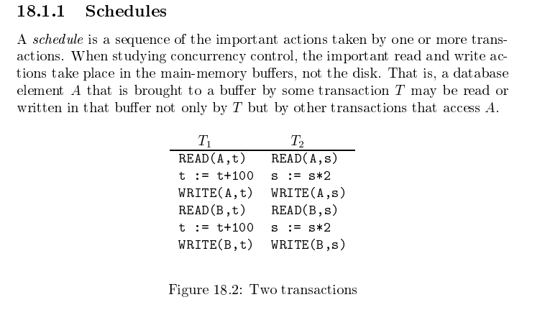
Schedule
Garcia-Molina et al.

Slide 107
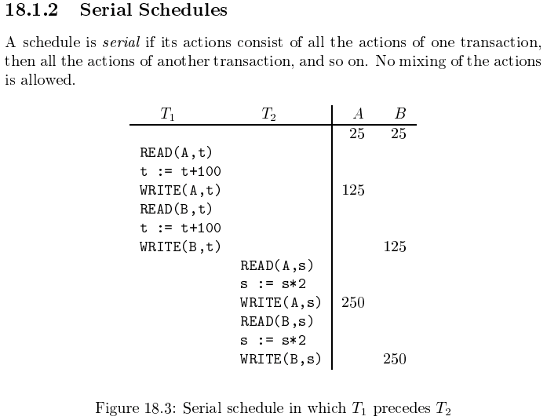
Serializable
Assume there are three
concurrently executing transactions
T1, T2 and T3
The transaction manager
Enables concurrent execution
But schedules individual operations
To ensure that the final DB state
Is equivalent to one of the following schedules
T1, T2, T3
T1, T3, T2
T2, T1, T3
T2, T3, T1
T3, T1, T2
T3, T2, T1
Concurrent execution was serializable.

Slide 108
Serializability (en.wikipedia.org/wiki/Serializability)
Serializability is used to keep the data in the data item in a consistent state. Serializability is a property of a transaction schedule (history). It relates to the isolation property of a database transaction.
Serializability of a schedule means equivalence (in the outcome, the database state, data values) to a serial schedule (i.e., sequential with no transaction overlap in time) with the same transactions. It is the major criterion for the correctness of concurrent transactions' schedule, and thus supported in all general purpose database systems.
The rationale behind serializability is the following:
If each transaction is correct by itself, i.e., meets certain integrity conditions,
then a schedule that comprises any serial execution of these transactions is correct (its transactions still meet their conditions):
"Serial" means that transactions do not overlap in time and cannot interfere with each other, i.e, complete isolation between each other exists.
Any order of the transactions is legitimate, (…)
As a result, a schedule that comprises any execution (not necessarily serial) that is equivalent (in its outcome) to any serial execution of these transactions, is correct.

Slide 109
Lock-Based Concurrency Control
Strict Two-phase Locking (Strict 2PL) Protocol:
Each Xact must obtain a S (shared) lock on object before reading, and an X (exclusive) lock on object before writing.
All locks held by a transaction are released when the transaction completes
(Non-strict) 2PL Variant: Release locks anytime, but cannot acquire locks after releasing any lock.
If an Xact holds an X lock on an object, no other Xact can get a lock (S or X) on that object.
Strict 2PL allows only serializable schedules.
Additionally, it simplifies transaction aborts
(Non-strict) 2PL also allows only serializable schedules, but involves more complex abort processing

Slide 110
Aborting a Transaction
If a transaction Ti is aborted, all its actions have to be undone. Not only that, if Tj reads an object last written by Ti, Tj must be aborted as well!
Most systems avoid such cascading aborts by releasing a transaction’s locks only at commit time.
If Ti writes an object, Tj can read this only after Ti commits.
In order to undo the actions of an aborted transaction, the DBMS maintains a log in which every write is recorded. This mechanism is also used to recover from system crashes: all active Xacts at the time of the crash are aborted when the system comes back up.

Slide 111
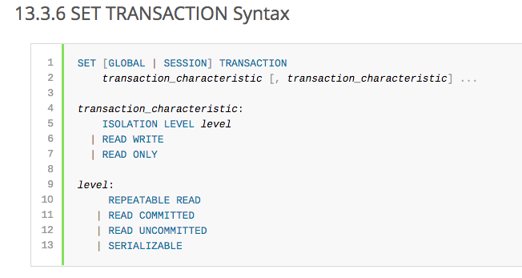
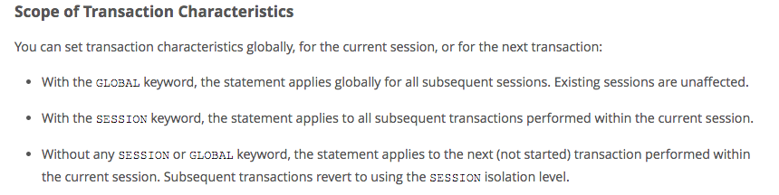
MySQL (Locking) Isolation

Slide 112
Isolation Levels (https://en.wikipedia.org/wiki/Isolation_(database_systems)
Not all transaction use cases require 2PL and serializable execution. Databases support a a set of levels.
Serializable
With a lock-based concurrency control DBMS implementation, serializability requires read and write locks (acquired on selected data) to be released at the end of the transaction. Also range-locks must be acquired when a SELECT query uses a ranged WHERE clause, especially to avoid the phantom reads phenomenon.
The execution of concurrent SQL-transactions at isolation level SERIALIZABLE is guaranteed to be serializable. A serializable execution is defined to be an execution of the operations of concurrently executing SQL-transactions that produces the same effect as some serial execution of those same SQL-transactions. A serial execution is one in which each SQL-transaction executes to completion before the next SQL-transaction begins.
Repeatable reads
In this isolation level, a lock-based concurrency control DBMS implementation keeps read and write locks (acquired on selected data) until the end of the transaction. However, range-locks are not managed, so phantom reads can occur.
Write skew is possible at this isolation level, a phenomenon where two writes are allowed to the same column(s) in a table by two different writers (who have previously read the columns they are updating), resulting in the column having data that is a mix of the two transactions.^{[3][4]}
Read committed
In this isolation level, a lock-based concurrency control DBMS implementation keeps write locks (acquired on selected data) until the end of the transaction, but read locks are released as soon as the SELECT operation is performed (so the non-repeatable reads phenomenon can occur in this isolation level). As in the previous level, range-locks are not managed.
Putting it in simpler words, read committed is an isolation level that guarantees that any data read is committed at the moment it is read. It simply restricts the reader from seeing any intermediate, uncommitted, 'dirty' read. It makes no promise whatsoever that if the transaction re-issues the read, it will find the same data; data is free to change after it is read.
Read uncommitted
This is the lowest isolation level. In this level, dirty reads are allowed, so one transaction may see not-yet-committed changes made by other transactions

Slide 113
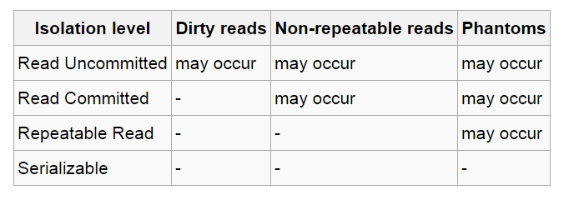
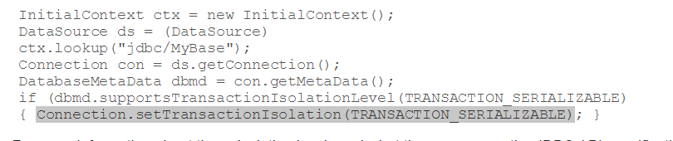
In Databases, Cursors Define Isolation
We have talked about ACID transactions
Atomic: A set of writes all occur or none occur.
Durable: The data “does not disappear,” e.g. write to disk.
Consistent: My applications move the database between consistent states, e.g. the transfer function works correctly.
Isolation
Determines what happens when two or more threads are manipulating the data at the same time.
And is defined relative to where cursors are and what they have touched.
Because the cursor movement determines what you are reading or have read.
But, … Cursors are client conversation state and cannot be used in REST.

Slide 114
Relational Database Design Normalization
114 | COMS W4111_002_2023_3: Lecture_11_Module_II_NoSQL_4 © Donald F. Ferguson, 2023

Slide 115
Overview of Normalization

Slide 116
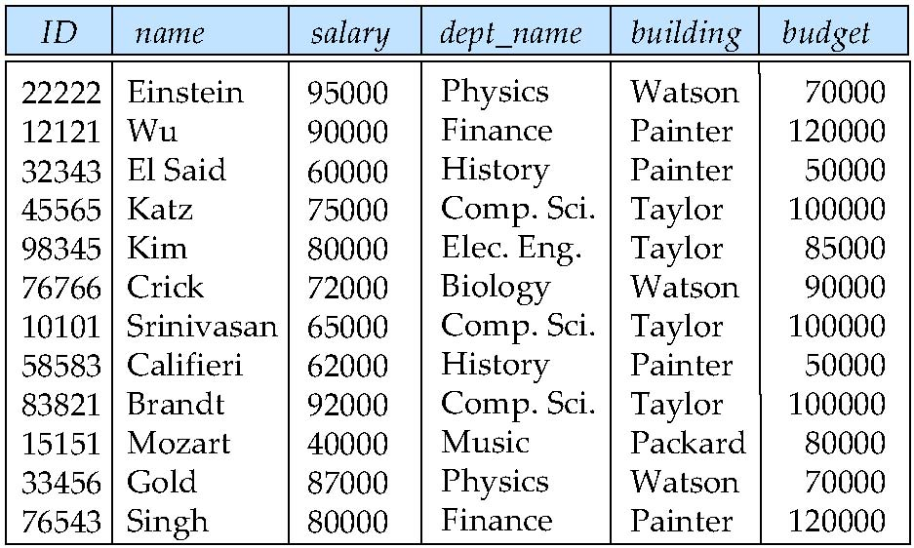
Features of Good Relational Designs
Hypothetically, assume our schema originally had one relation that provided information about faculty and departments.
Suppose we combine instructor and department into in_dep, which represents the natural join on the relations instructor and department
There is repetition of information
Need to use null values (if we add a new department with no instructors)
X → Y
X = (dept_name)
Y = (building, budget)
Pix Physics
Pix Physics
Piy (Watson, 70000)

Slide 117
Decomposition
The only way to avoid the repetition-of-information problem in the in_dep schema is to decompose it into two schemas – instructor and department schemas.
Not all decompositions are good. Suppose we decompose
employee(ID, name, street, city, salary)
into
employee1 (ID, name)
employee2 (name, street, city, salary)
The problem arises when we have two employees with the same name
The next slide shows how we lose information -- we cannot reconstruct the original employee relation -- and so, this is a lossy decomposition.

Slide 118
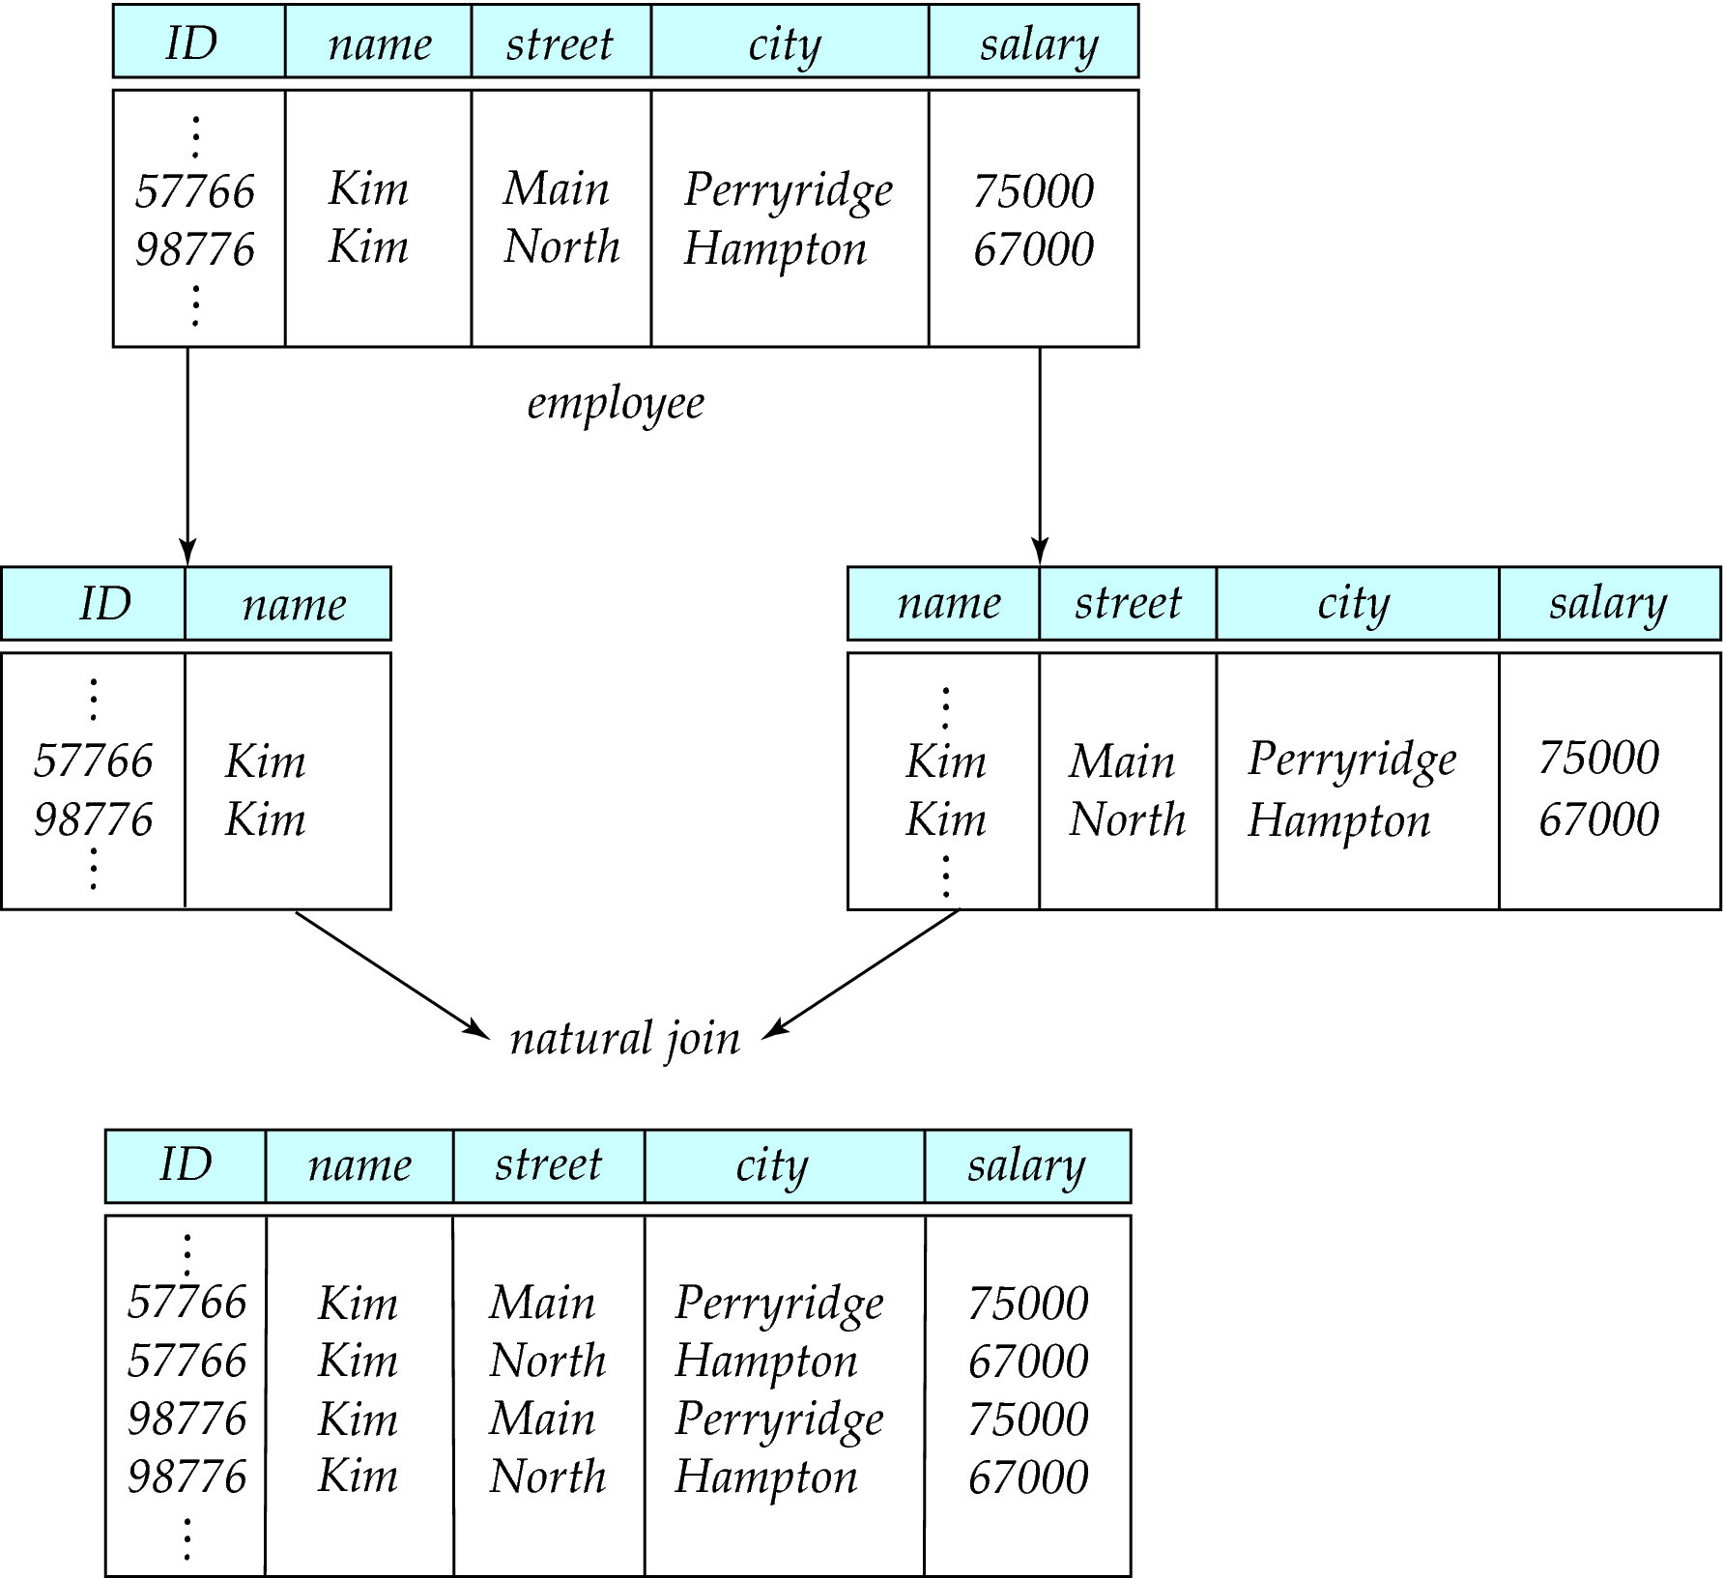
Lossy Decomposition

Slide 119
The Evils of Redundancy
Redundancy is at the root of several problems associated with relational schemas:
redundant storage, insert/delete/update anomalies
Integrity constraints, in particular functional dependencies, can be used to identify schemas with such problems and to suggest refinements.
Main refinement technique: decomposition (replacing ABCD with, say, AB and BCD, or ACD and ABD).
Decomposition should be used judiciously:
Is there reason to decompose a relation?
What problems (if any) does the decomposition cause?
Notes:
14

Slide 120
Example (Contd.)
Wages
Hourly_Emps2
Problems due to R W :
Update anomaly: Can we change W in just the 1st tuple of SNLRWH?
Insertion anomaly: What if we want to insert an employee and don’t know the hourly wage for his rating?
Deletion anomaly: If we delete all employees with rating 5, we lose the information about the wage for rating 5!
Will 2 smaller tables be better?
Notes:
17

Slide 121
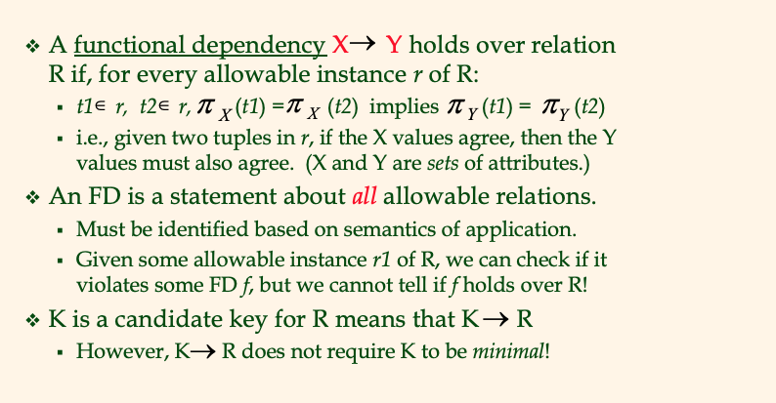
Functional Dependencies (FDs)
Notes:
15

Slide 122
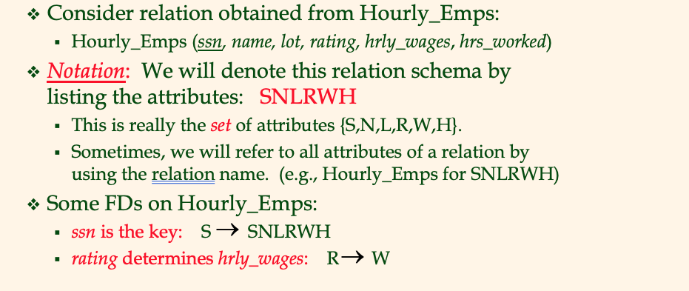
Example: Constraints on Entity Set
Notes:
16

Slide 123
F⁺
(uni, email, last_name, first_name) uni and email are candidate (not NULL, unique)
Uni → email
Email → (last_name, first_name)
➔ Uni → (last_name, first_name)
Person:(uni, email, last_name, first_name), ContactInfo: (email, phone_number, dorm_name)
Uni → email
Email → phone_number, dorm_name
Uni → phone_number, dorm_name

Slide 124
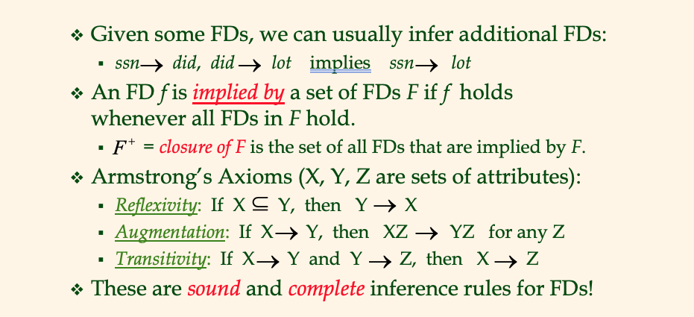
Reasoning About FDs
Notes:
19

Slide 125
Lossless Decomposition
Let R be a relation schema and let R₁ and R₂ form a decomposition of R.
That is R = R₁ U R₂
Note: This notation is confusing. This is a statement about the schema, not about the data in relations.
We say that the decomposition is a lossless decomposition if there is no loss of information by replacing R with the two relation schemas R₁ U R₂
Formally,
∏ _{R1} (r) ∏ _{R2} (r) = r
And, conversely a decomposition is lossy if
r ⊂ ∏ _{R1} (r) ∏ _{R2} (r) = r

Slide 126
Normalization Theory
Decide whether a particular relation R is in “good” form.
In the case that a relation R is not in “good” form, decompose it into set of relations {R₁, R₂, ..., R_{n}} such that
Each relation is in good form
The decomposition is a lossless decomposition
Our theory is based on:
Functional dependencies
Multivalued dependencies

Slide 127
Functional Dependencies
There are usually a variety of constraints (rules) on the data in the real world.
For example, some of the constraints that are expected to hold in a university database are:
Students and instructors are uniquely identified by their ID.
Each student and instructor has only one name.
Each instructor and student is (primarily) associated with only one department.
Each department has only one value for its budget, and only one associated building.

Slide 128
Functional Dependencies (Cont.)
An instance of a relation that satisfies all such real-world constraints is called a legal instance of the relation;
A legal instance of a database is one where all the relation instances are legal instances
Constraints on the set of legal relations.
Require that the value for a certain set of attributes determines uniquely the value for another set of attributes.
A functional dependency is a generalization of the notion of a key.

Slide 129
Functional Dependencies Definition
Let R be a relation schema
α ⊆ R and β ⊆ R
The functional dependency
α → β
holds on R if and only if for any legal relations r(R), whenever any two tuples t₁ and t₂ of r agree on the attributes α, they also agree on the attributes β. That is,
t₁[α] = t₂ [α] ⇒ t₁[β ] = t₂ [β ]
Example: Consider r(A,B ) with the following instance of r.
On this instance, B → A hold; A → B does NOT hold,
4
1 5
3 7

Slide 130
Closure of a Set of Functional Dependencies
Given a set F set of functional dependencies, there are certain other functional dependencies that are logically implied by F.
If A → B and B → C, then we can infer that A → C
etc.
The set of all functional dependencies logically implied by F is the closure of F.
We denote the closure of F by F⁺.

Slide 131
Keys and Functional Dependencies
K is a superkey for relation schema R if and only if K → R
K is a candidate key for R if and only if
K → R, and
for no α ⊂ K, α → R
Functional dependencies allow us to express constraints that cannot be expressed using superkeys. Consider the schema:
in_dep (ID, name, salary, dept_name, building, budget ).
We expect these functional dependencies to hold:
dept_name→ building
ID → building
but would not expect the following to hold:
dept_name → salary
DFF Note:
In the current data: ID → dept_name → building
But
In the schema, dept_name may be NULL..

Slide 132
Use of Functional Dependencies
We use functional dependencies to:
To test relations to see if they are legal under a given set of functional dependencies.
If a relation r is legal under a set F of functional dependencies, we say that r satisfies F.
To specify constraints on the set of legal relations
We say that F holds on R if all legal relations on R satisfy the set of functional dependencies F.
Note: A specific instance of a relation schema may satisfy a functional dependency even if the functional dependency does not hold on all legal instances.
For example, a specific instance of instructor may, by chance, satisfy name → ID.

Slide 133
Normal Forms

Slide 134
Boyce-Codd Normal Form
A relation schema R is in BCNF with respect to a set F of functional dependencies if for all functional dependencies in F⁺ of the form
α → β
where α ⊆ R and β ⊆ R, at least one of the following holds:
α → β is trivial (i.e., β ⊆ α)
α is a superkey for R
DFF Note:
The theoretical treatment is no conveying the practical intent.
If α is α superkey, I can set a primary key/unique constraint on α.
Consider tables with address info in the rows.

Slide 135
Decomposing a Schema into BCNF
Let R be a schema R that is not in BCNF. Let α →β be the FD that causes a violation of BCNF.
We decompose R into:
(α U β )
( R - ( β - α ) )
In our example of in_dep,
α = dept_name
β = building, budget
and in_dep is replaced by
(α U β ) = ( dept_name, building, budget )
( R - ( β - α ) ) = ( ID, name, dept_name, salary )
Note:
This is an example only.
Zip code does not imply city or state in real world.
DFF Note – again this is baffling
R = (id, name_last, name_first, street, city, state, zipcode)
α → β means zipcode → (city, state)
(α U β ) = (zipcode, city, state), which we call Address
R - ( β - α ) ). = R - β + α = (id, name_last, name_first, zipcode), which we call Person
Setting primary key ID in Address and zipcode on Address preserves the dependency and is lossless.

Slide 136
BCNF and Dependency Preservation
It is not always possible to achieve both BCNF and dependency preservation
Consider a schema:
dept_advisor(s_ID, i_ID, department_name)
With function dependencies:
i_ID → dept_name
s_ID, dept_name → i_ID
dept_advisor is not in BCNF
i_ID is not a superkey.
Any decomposition of dept_advisor will not include all the attributes in
s_ID, dept_name → i_ID
Thus, the composition is NOT be dependency preserving

Slide 137
Third Normal Form
A relation schema R is in third normal form (3NF) if for all:
α → β in F⁺
at least one of the following holds:
α → β is trivial (i.e., β ∈ α)
α is a superkey for R
Each attribute A in β – α is contained in a candidate key for R.
(NOTE: each attribute may be in a different candidate key)
If a relation is in BCNF it is in 3NF (since in BCNF one of the first two conditions above must hold).
Third condition is a minimal relaxation of BCNF to ensure dependency preservation (will see why later).

Slide 138
3NF Example
Consider a schema:
dept_advisor(s_ID, i_ID, dept_name)
With function dependencies:
i_ID → dept_name
s_ID, dept_name → i_ID
Two candidate keys = {s_ID, dept_name}, {s_ID, i_ID }
We have seen before that dept_advisor is not in BCNF
R, however, is in 3NF
s_ID, dept_name is a superkey
i_ID → dept_name and i_ID is NOT a superkey, but:
{ dept_name} – {i_ID } = {dept_name } and
dept_name is contained in a candidate key

Slide 139
Comparison of BCNF and 3NF
Advantages to 3NF over BCNF. It is always possible to obtain a 3NF design without sacrificing losslessness or dependency preservation.
Disadvantages to 3NF.
We may have to use null values to represent some of the possible meaningful relationships among data items.
There is the problem of repetition of information.

Slide 140
Goals of Normalization
Let R be a relation scheme with a set F of functional dependencies.
Decide whether a relation scheme R is in “good” form.
In the case that a relation scheme R is not in “good” form, need to decompose it into a set of relation scheme {R₁, R₂, ..., R_{n}} such that:
Each relation scheme is in good form
The decomposition is a lossless decomposition
Preferably, the decomposition should be dependency preserving.

Slide 141
Denormalization for Performance
May want to use non-normalized schema for performance
For example, displaying prereqs along with course_id, and title requires join of course with prereq
Alternative 1: Use denormalized relation containing attributes of course as well as prereq with all above attributes
faster lookup
extra space and extra execution time for updates
extra coding work for programmer and possibility of error in extra code
Alternative 2: use a materialized view defined a course prereq
Benefits and drawbacks same as above, except no extra coding work for programmer and avoids possible errors

Slide 142
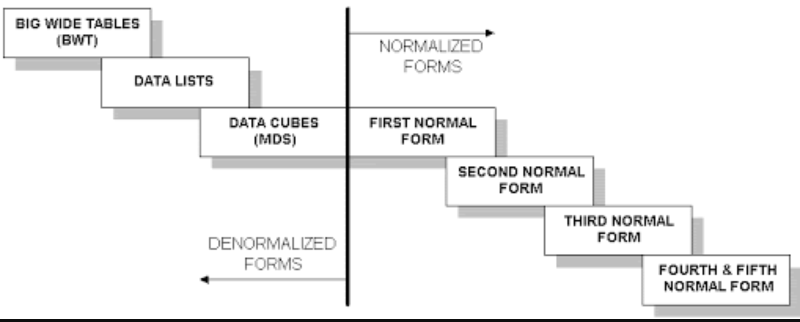
Wide Flat Tables
Good for Integrity
Good for Query
Improve query performance by precomputing and saving:
JOINs
Aggregation
Derived/computed columns
One of the primary strength of the relational model is maintaining “integrity” when applications create, update and delete data. This relies on:
The core capabilities of the relational model, e.g. constraints.
A well-design database (We will cover a formal definition – “normalization” in more detail later.
Data models that are well designed for integrity are very bad for read only analysis queries. We will build and analyze wide flat tables as part of the analysis tasks in HW3, HW4 as projects.

Slide 143
First Normal Form
Domain is atomic if its elements are considered to be indivisible units
Examples of non-atomic domains:
Set of names, composite attributes
Identification numbers like CS 101 that can be broken up into parts
A relational schema R is in first normal form if the domains of all attributes of R are atomic
Non-atomic values complicate storage and encourage redundant (repeated) storage of data
Example: Set of accounts stored with each customer, and set of owners stored with each account
We assume all relations are in first normal form (and revisit this in Chapter 22: Object Based Databases)

Slide 144
First Normal Form (Cont.)
Atomicity is actually a property of how the elements of the domain are used.
Example: Strings would normally be considered indivisible
Suppose that students are given roll numbers which are strings of the form CS0012 or EE1127
If the first two characters are extracted to find the department, the domain of roll numbers is not atomic.
Doing so is a bad idea: leads to encoding of information in application program rather than in the database.

